Slide 1
Service Voter and Special Voter – Sec. 20 of the R. P. Act, 1950 Special procedure for voting by certain classes of persons – Sec. 60 of the R. P. Act., 1951 Operative portions – Rules 17 to 27Q of the Conduct of Elections Rules, 1961
POSTAL BALLOT AND ETPB (PREPARATION, VOTING AND COUNTING)

Slide 2
PB/ETPB : ENTITLED CATEGORIES OF ELECTORS
Service Voters
(including Spouse)
except those who opted for proxy voting
Notified Voters
AVSC, AVPD, AVCO+AVES
Voters on Election Duty
Special Voters
(including Spouse)
who are holding declared offices
Preventive Detention
Voters under preventive Detention

Slide 3
SERVICE VOTERs
Service Voters’ names will be in the last part of the ER.
Will be issued etPB without F/12.
etPBs are to be issued within 24 hours of finalization of candidates (7A).
Who are service voters ?
A member of the armed forces of the union.
Members of a force to which the provisions of the Army Act,1950 (46 of 1950) have been made applicable.
Members of an armed forces of a state serving outside their state.
Persons who are employed under the GOI on a part outside India. e.g. Ambassadors of India.

Slide 4
SPECIAL VOTERs – 20 (4) RPA’1950
The President /Vice President of India.
Governors of State.
Cabinet Ministers/MoS/Dy MoS/Parliamentary Secretaries of the Union/State.
The Dy. Chairman & Members of NITI Ayog.
The Speaker/Dy Speaker of the House of people or of any state legislative Assembly.
The Chairman/Dy Chairman of any State legislative Council .
Lieutenant Governors of UTs.
Special voter will intimate RO for PB in form 12 at least 10 day before poll. PB will be sent by RPAD(Registered post with acknowledgement due) or personally delivered.
The names of special voters will not be found in the last part of the electoral roll.

Slide 5
ELECTORS SUBJECTED TO PREVENTIVE DETENTION
They may apply directly to RO for PB
or
Home department will communicate to RO specifying name , address , Part No. & Sr. No. in the roll and place of detention within 15 days of notification of election.
Before sending PB ,it is to be ensured that the name entered in the roll and the person held under preventive detention is identical and same.
The names of electors in preventive detention will not be found in the last part of the electoral roll.

Slide 6
ELECTORS ON ELECTION DUTY
Persons and Staff deployed on election duty on the day of poll & are not able to vote at normal P.S. Viz...
Polling Personnel- PrO & Pos.
Polling agents.
All police personnel (except those on leave).
DEOs/ROs/AROs & their Staff, Control Room Staff.
Staff of EEM Teams/SOs, BLO, MOs,
Videographers/ Drivers/Conductors/ Cleaners etc.

Slide 7


If on duty in a constituency other than the constituency where they are enrolled as a voters.
ELECTORS ON ELECTION DUTY
Ele
Election Duty Certificate (EDC)
In case a government official is on election duty in the same constituency in which enrolled as a voter. (vote at the polling station where they are on duty).

Slide 8
Notified Voters- S60 (C) RPA’1951
(AVSC/AVPD/AVCO + AVES)
AVSC- Electors above the age of 80 years
AVPD- Electors who are marked as PwD
AVCO- Electors infected with COVID-19
AVES- Electors employed in essential services or any other category of electors notified by ECI
One ARO is assigned to handle all work related to PB voting by Absentee Voters.
voting is done at their residences and marked PB are collected from their residencies, This will be calling as Home Voting
voting is done at Postal Voting Center(PVC).

Slide 9
CSV / PROXY VOTING
Service voters have been provided the facility to vote either through proxy or through etPBS.
Proxy Voters-
Should be at least 18 yrs of age & from the same AC.
Shall not be disqualified as an elector.
Appointment in 13/F and to be reached to RO before last date of nomination.
Will be valid unless & until revoked in form 13/G or the proxy dies or the service voter retires.
RO will prepare a list of CSV and Proxy with address just after the last day of nomination and will add it to electoral roll to be used during poll.
CSV should be marked in ER against the name of that service voter.

Slide 10
Mode of issue and return of PB
By Post Only | FC/PVC only | Residence/ Hospital/ Polling Party | FC ONLY
Service Voters Special Voters Electors subjected to preventive detention | Voters employed in essential services Notified electors (As in case of Kashmiri migrants. Bru/Reang voters at transit camps in Tripura) | Senior Citizen PwD COVID affected | Voters on election duty
Voters whose form has been approved by RO for issue of PB are NOT ENTITLED TO VOTE AT POLLING STATION.

Slide 11
Specified Forms (CER 1961)
Form 12- Application for PB for
Special Voter (Rule 19) – at least 10 days before poll day
Voter on election duty (Rule 20(1))– at least 7 days before poll day or such shorter period as allowed by RO
Form 12A –Application for EDC for voter on election duty (Rule 20(2))- 4 days before poll day or such shorter period as allowed by RO
Form 12B- EDC by RO (Rule 20 (2)(a))
Form 12C- Application for PB for notified electors other than absentee voters) (Rule 27C)
Form 12D- Application for PB for absentee voters
Form 13A- Declaration by elector [Rule 23 (1)]
Form 13B (Cover A)- Small envelope [Rule 23 (1)]
Form 13C (Cover B)- Large envelope [Rule 23 (1)]
Form 13D- Instructions for electors [Rule 23 (1)]

Slide 12
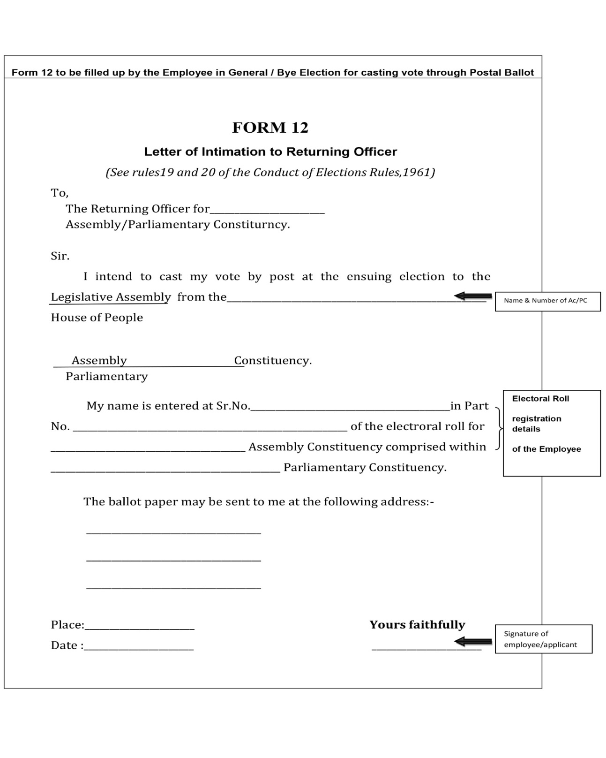
Form 12

Slide 13
DESIGN OF POSTAL BALLOT PAPERS
Names of candidates shall be arranged in the same order under 3 categories in which they appear in the list of contesting candidates (Form 7A). However, headings of categories should not appear in PBs.
“None of the Above” option shall be printed in a separate panel after the name of all the contesting candidates

Slide 14
PRINTING OF POSTAL BALLOT PAPERS
DEO is responsible for printing of PB for all ACs/ PCs within the District
Preparation/generation of PBs for service voters (through ETPBS) should be completed within 24 hours of finalization of list of contesting candidates.
For other categories, PBs should be printed within 72 hours of finalization of candidates.
To be stitched in bundles of 50 ballot papers
Ensure that Sl. No. on postal ballot and on its counterfoil are identical

Slide 15
DETAILS TO BE PRINTED ON PB
PB for Service Voters | PB for other categories
Names of Candidates (In State language and English) | Names of Candidates (In State language and English)
Photographs of Candidates | Photographs of Candidates
Party Affiliation of Candidates (In State language and English) | NO PARTY AFFILIATION
NO ELECTION SYMBOLS OF CANDIDATES | ELECTION SYMBOLS OF THE CANDIDATES PRINTED
Width – Between 4” and 6” | Width – Between 4” and 6”

Slide 16
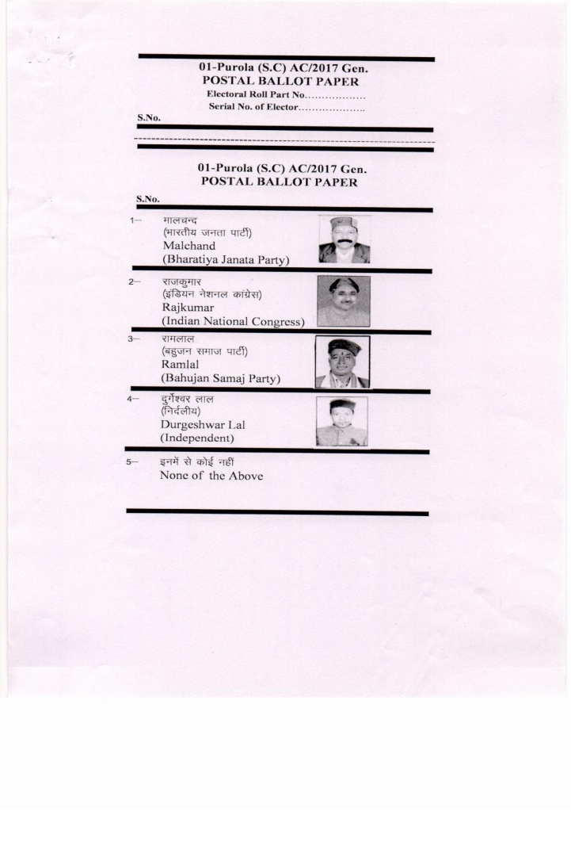
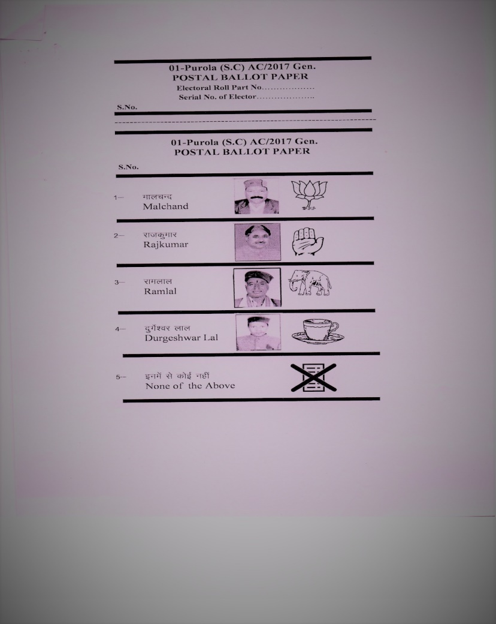
DESIGN OF POSTAL BALLOT
SERVICE VOTER OTHER THAN SERVICE VOTER

Slide 17
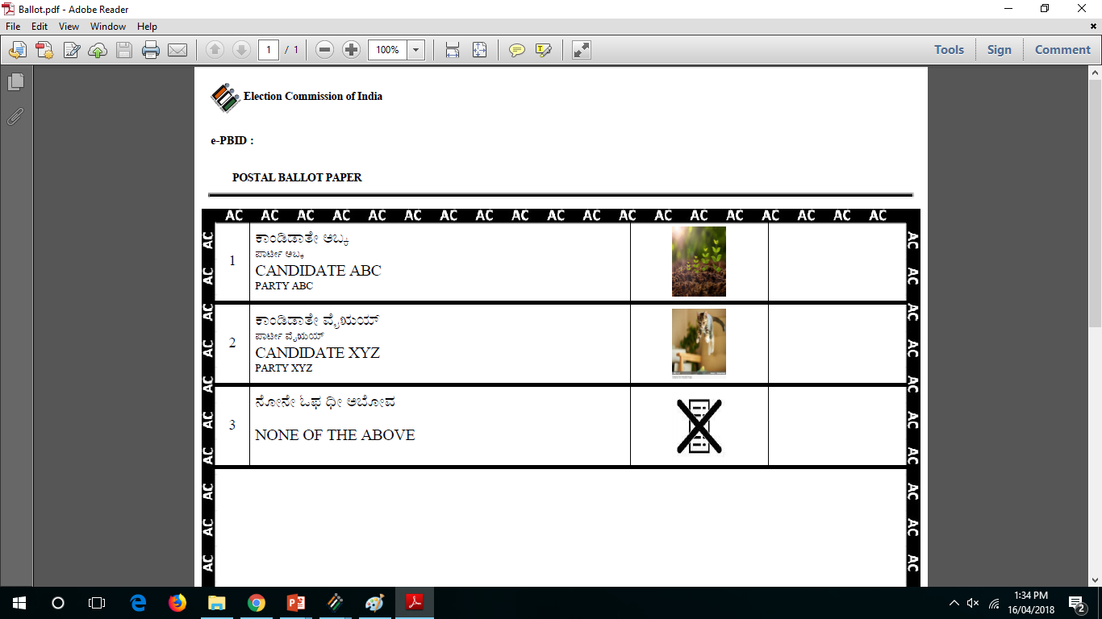
ELECTRONICALLY TRANSMITTED POSTAL BALLOT
SAMPLE

Slide 18
FORMAT OF PB
Form 13-A (Declaration)
Form 13-B (Cover-A)
Form 13-C (Cover-B)
Form 13-D (Instructions)
Postal Ballot
After casting vote PB is kept inside Form 13-B/Cover A.
Form 13-B & 13-A is kept inside 13C & drop 13C in drop box.

Slide 19
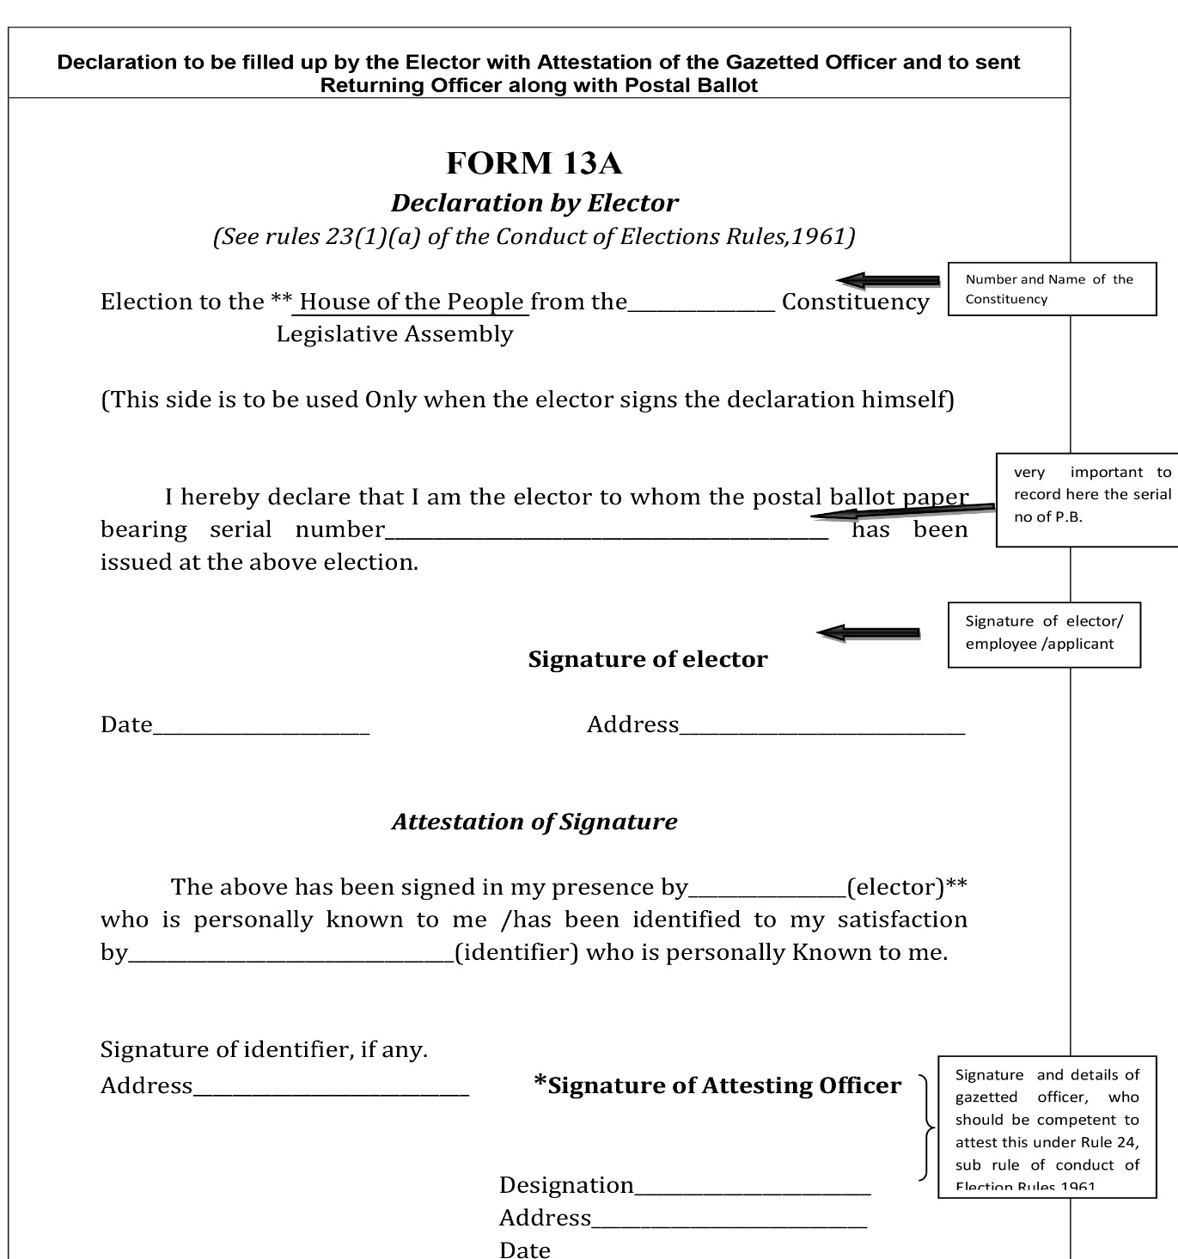

Slide 20


FORM 13A
{See rule 23(1)(a)]
DECLARATION BY ELECTOR
Election to the . 73 – Khairagarh Assembly Constituency .
(THIS SIDE IS TO BE USED ONLY WHEN THE ELECTOR SIGNS THE DECLARATION HIMSELF)
I hereby declare that I am the elector to whom the postal ballot paper bearing serial number 133 . has been issued at the above election.
Date: 13/04/2022 Signature of elector
Address H.No. 12/A, Civil lines, Khairagarh
Attestation of Signature
The above has been signed in my presence by . Shri. Krishna Sahu (elector) who is personally known to me/has been identified to my satisfaction by . Mrs. Nandini Verma (identifier) who is personally known to me.
Signature of Identifier, if any Signature of Attesting Officer
Address . LG-01, Civil lines, Khairagarh Designation: Deputy Director .
Date : . 13/04/2022 . Address Collectorate, Khairagarh.
KCG .

Slide 21
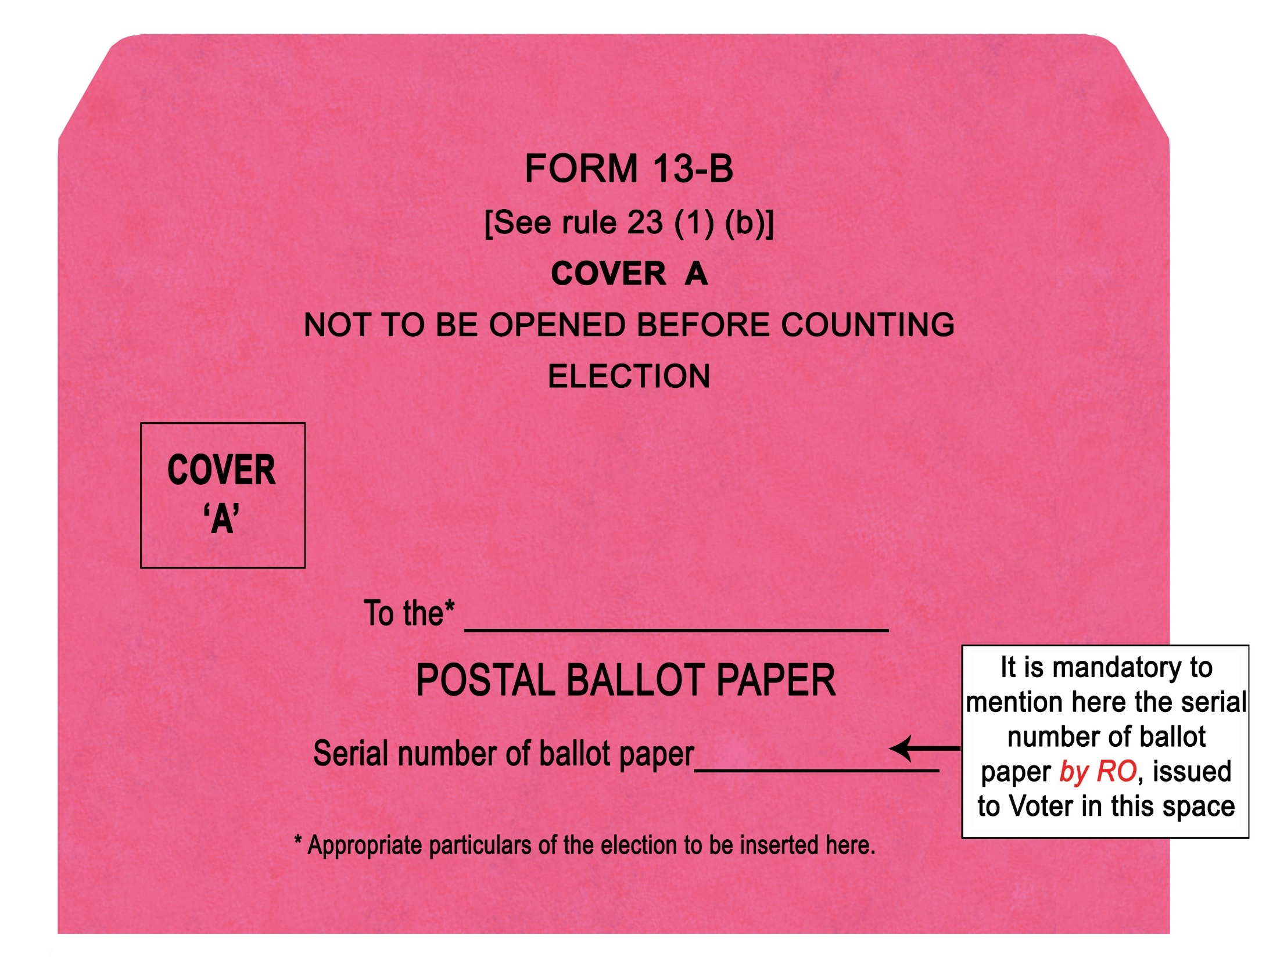

Slide 22

FORM 13B
[ See Rule 23 (1) (b) ]
COVER
A
NOT TO BE OPENED BEFORE COUNTING
ELECTION to the . Chhattisgarh Legislative Assembly .
from the . 73 – Khairagarh Assembly Constituency
POSTAL BALLOT PAPER
Serial number of Ballot Paper . 133 .

Slide 23
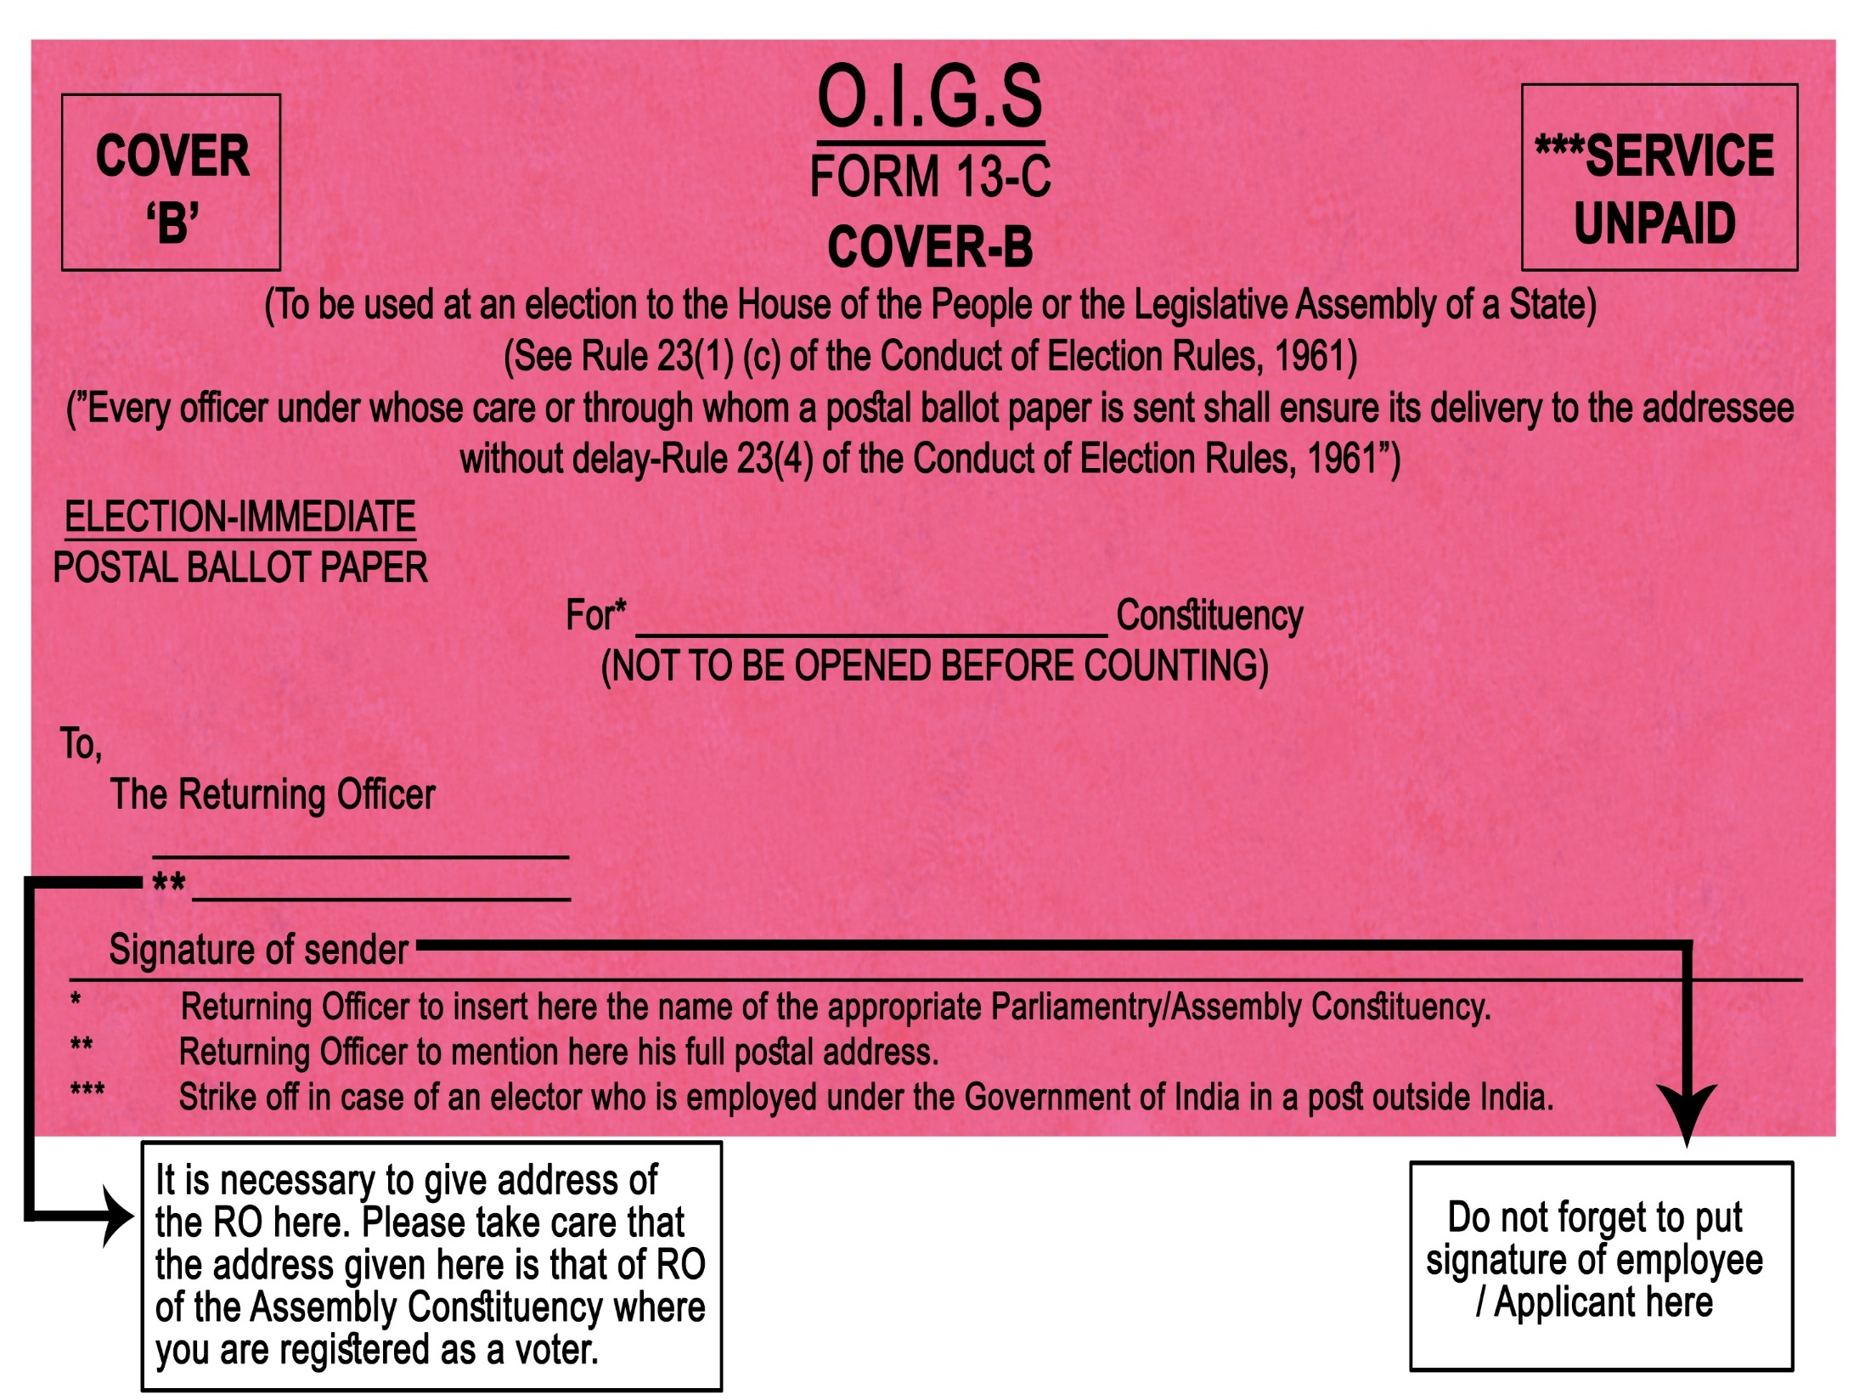

Slide 24
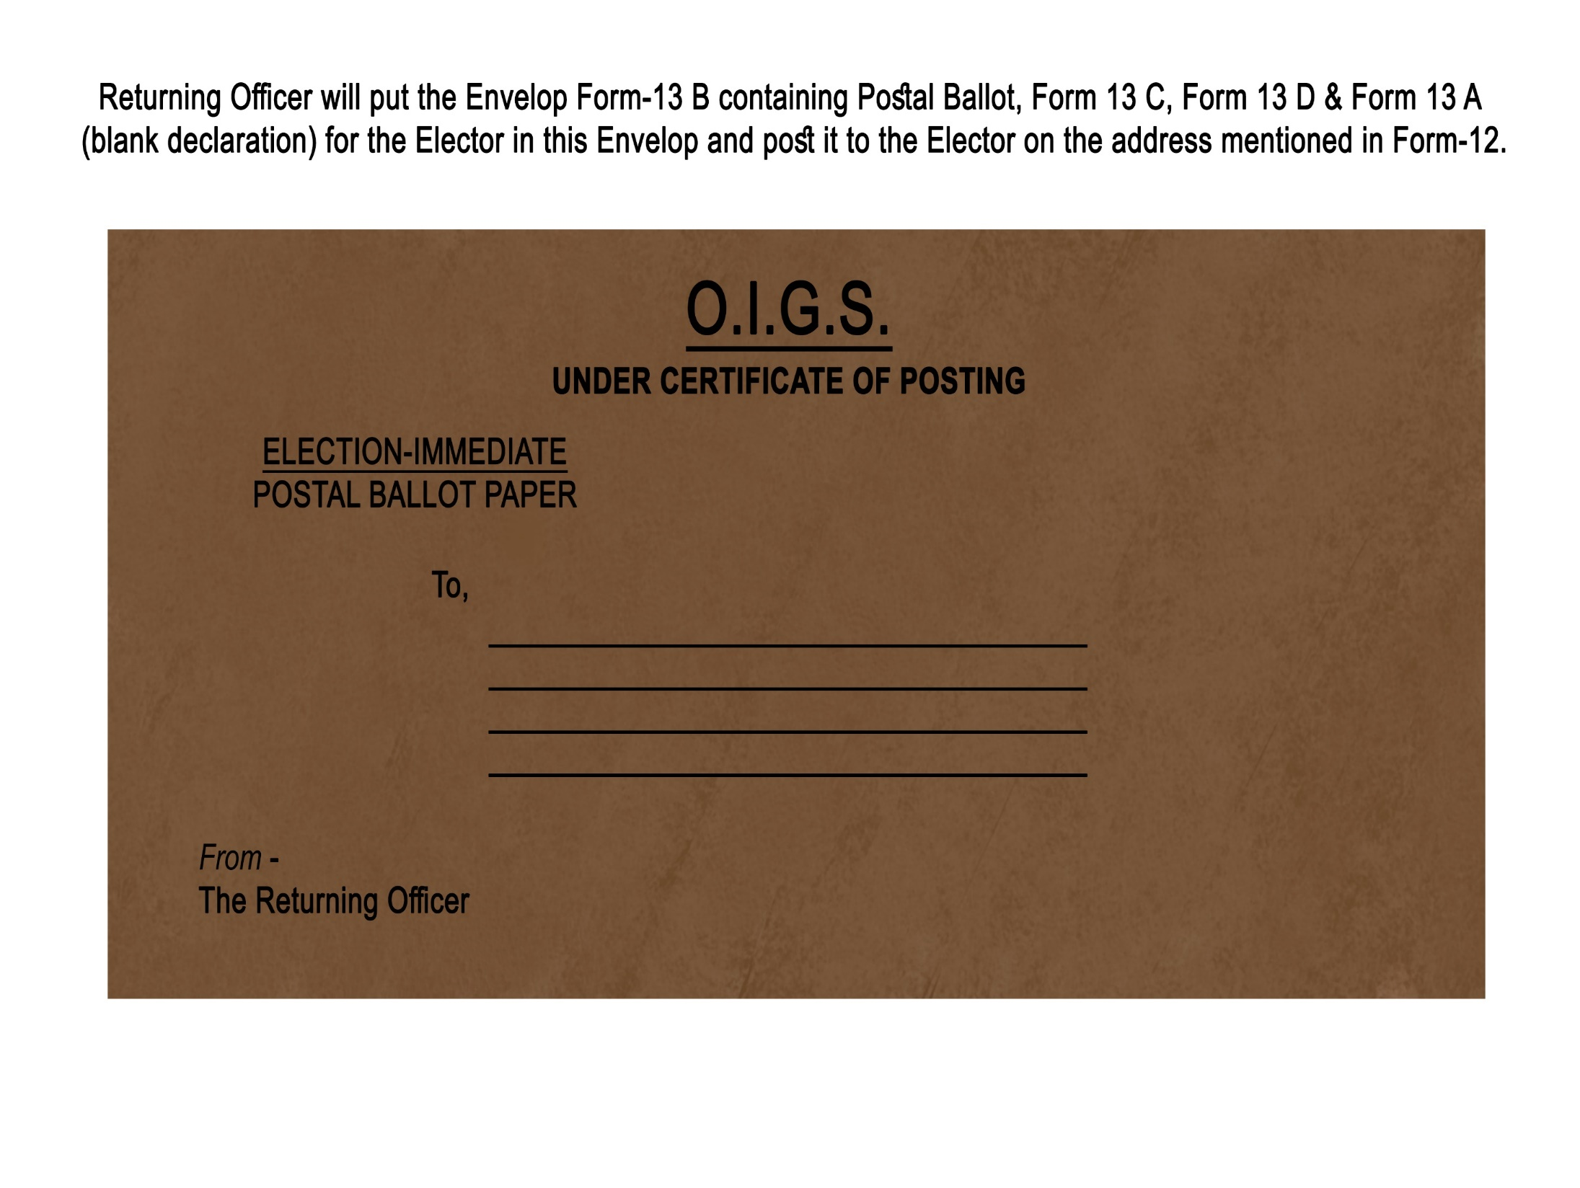

Slide 25
COLOUR OF PB AND ENVELOPEs
Service Voters – PB and Envelopes – White
[Now Envelopes are not required to be sent by CEOs to the Record / Unit Officers for use by Service Voters]
Other than Service Voters – PB and Envelopes – White for PC & Pink for AC
Postage Stamp
No need to be affixed on envelope by service voter – DoP has been instructed. Expenditure to be borne by CEO
CEO to inform GM, Post Office to accept envelopes for speed post delivery
Postal deptt shall nominate on Post Office for each PC/AC for delivery of PB to RO

Slide 26
DISPATCH OF PB (GENERAL INSTRUCTION)
Procedure for despatch of PB:
Send following documents (i) PB, (ii)Form-13A (Declaration), (iii) Form 13B (Inner Envelope) (iv) Form 13C (Outer Envelope) and (v) Form-13D (Instruction)
NB: For Service Voters the above will be transmitted electronically through ETPBS
Record the electoral roll number (Part No. and Sl.No. as entered in the marked copy) on the counterfoil of PB
In the Marked Copy of the ER, PB in RED ink should be written against the names of all who have been issued PBs.
PB serial no. should NOT be written against the voter’s entry.
No PB can be issued after the stage of preparing marked copy of electoral roll for supply to the presiding officers for conduct of poll.

Slide 27
DISPATCH OF PB (GENERAL INSTRUCTION)
Steps to remember for preparing marked copy of ER -
PB serial no. should be written on Form 13-B (Cover A - inner cover) without fail.
NB: PB liable for rejection, if PB Serial number not mentioned
Classified Service Voter (CSV) should be marked in the Electoral Roll against the entries of the voters who have opted for proxy (R 27P COER, 1961)
EDC should be marked against the entries of voters to whom EDC has been issued.
Seal the counterfoils with proper description and date (R 23(6) COER, 1961)
Proper account of PB and EDC issued to be maintained in a Register.
The team entrusted with preparing Marked Copies of ER, may also be entrusted with issuance of PBs for better results/efficiency
Ensure that electors issued with PB are not allowed to vote at Polling Station
NB: The above are pointers are aimed at ensuring that electors issued with PB are debarred from voting at the Polling Station

Slide 28
MARKED COPY
In the Marked Copy of the ER, PB in RED ink should be written against the names of all who have been provided with the Postal ballots.
PB serial no. should NOT be written against the voter’s entry.
PB serial no. should be written on cover A (13-B) without fail. (Imp. Reason of Rejection, if not found)
CSV should be marked against the entry of a voter opted for proxy.
In any case only one Marked Copy should be used as a Master copy for issuing PBs to avoid any mistake.

Slide 29
ISSUE OF EDC TO VOTER ON ELECTION DUTY
Application in FORM 12A to the RO at least 7 days before the date of poll.
The RO, after due scrutiny of form, issues .an Election Duty Certificate in FORM 12B.
The Election Duty Certificate in Form 12B shall be printed in adequate number either centrally by the CEO or the DEO, as may be convenient. and each such certificate shall be serially numbered with a unique serial number.

Slide 30
VOTERS ON ELECTION DUTY
FACILITATION CENTRE –
AT TRAINING VENUE – Polling Parties and associated civilian staff –
TRAINING HOURS ON 2ND AND SUBSEQUENT TRAINING
AT RO’S OFFICE – Other than the above and for Police Personnel
NORMAL OFFICE HOURS, P-3 TO P-1 DAY OR EARLIER
FC – Group B or above as in-charge + 3 staff
Separate Drop box for each AC
Voting compartment, stationery items & Indelible ink
Videography
Candidates agents
Daily storage and record in special strong room
Appointment of Gazetted Officers, at the FC for verification/attestation of declaration in Form 13A.
Candidates are permitted to appoint their agents to watch the voting process, at the facilitation canter. ROs shall intimate the candidates about the schedule of the facilitation centre in advance.
RO to send information to DEO; DEO to CEO; CEO to ECI [Format 1, 2, 3]

Slide 31
Voters on Election Duty - Issue of PB – eligibility – printing – application – database - Facilitation Centre - Drop Box - design thereof – Sorting AC-wise – presence of representatives of candidates - Account Register – sealing in envelopes and dispatch to RO
Preparation of database of employees working in the district:
Database of all voters on election duty.
Include all employees of State Govt., Central Govt. and Central and State PSUs., all police personnel posted in the district including Home Guards etc. and drivers, conductors and cleaners of Govt. vehicles, vehicles of State Road Transport Corporation etc. in the database.
Include drivers, conductors and cleaners of private vehicles in the district like trucks, buses, minibuses etc. with the help of vehicle owners associations.
All electoral information of the employees – like complete residential address where the staff is enlisted in the electoral Roll, No. & name of Assembly Constituency, Part No. and the serial number at which the name is registered, EPIC No., and Cell Phone numbers and email Ids etc. needs to be incorporated in the database.

Slide 32
VOTERS ON ELECTION DUTY – SORTING OF POSTAL BALLOTS
End-of-poll procedure at facilitation center on each day:
After all postal ballots for the day have been cast; the drop box will be opened by the officer in-charge of the FC in the presence of the representatives of candidates, who may be present.
All the postal ballots will be taken out of the box and the empty box will be shown to the said representatives of political parties.
The postal ballot envelops will be sorted Assembly Constituency wise and the number of postal ballot envelopes received for each Assembly Constituency will be entered in a register in Format-1 (ECI Instruction) to be maintained for this purpose at the facilitation center.

Slide 33
Format -1
Statement regarding Postal Ballots cast at Facilitation Center
Name of State Name of Facilitation Center__________
Name of District___________ Name & designation of
Officer-in-charge
S.No. | Date | No.& Name of the Parliamentary /Assembly constituency | Total Number of postal ballots cast
Total for the Date
Cumulative Total Till Date

Slide 34
Format -2
District-wise Statement of Postal Ballots Cast at Facilitation Centers within the district
(To be prepared on each day facilitation is provided)
Name of State_________
Name of District _________
No. & Name of Parliamentary/Assembly Constituency(ies)_____________
Date of facilitation _______________
S.No. | Name of Facilitation Center | Total Number of postal ballots cast for the Parliamentary / Assembly Constituency
 |  | On Date | Till Date
Total for District
Total for State

Slide 35
VOTERS ON ELECTION DUTY–SORTING OF PB
AC-wise sorting of polled PBs and dispatch to ROs
Representatives of candidates present will be requested to put their signatures on the register and will be given a copy of the relevant pages of the register.
All postal ballot envelopes for one AC will be kept in a large envelope meant for that AC. The name of the Facilitation Centre, the date of Facilitation and the number of PBs contained therein will be clearly written on this envelope.
This envelope will then be sent to RO of the concerned AC along with a copy of the relevant pages of the register through special messenger appointed by RO for this purpose not below the rank of Deputy Tehsildar.

Slide 36
REGISTER OF ALL PBs
Maintenance, Sealing and safe custody of Register of all PB papers
A separate register to keep a record of issue of PBs to all categories and PBs received back should be maintained (no specific format provided by ECI)
The register should be sealed in the same manner as the Register of Voters in Form 17A used in polling stations.
It should be kept along with other statutory covers mentioned in R 93 (1) COER, 1961.
Copy of this register can be given to the candidates who demand for it after the date of poll in the constituency.
NB: This Register needs to contain an account of ALL PBs issued to ALL categories of electors (Service, Absentee, Election Duty, Special, Preventive Detention and other notified categories, if any and, etc.)

Slide 37
Format-1:
Account Register Of Postal Ballot Papers Issued to Persons Drafted For Election Duty
Number and name of the Assembly Constituency::__________________
Date of Training Session at which facilitation centre was provided____________________ (if there are more than one date, information may be maintained separately for each date) Place of facilitation Centre________________________________________________________
Running Sl. No. | Part No. of electoral roll | Sl. No. of elector in the electoral roll | Details of the document produced by the elector in proof of his / her identification | Signature / L.T.I. of elector | Remarks
1 | 2 | 3 | 4 | 5 | 6
Contd…

Slide 38
PROCEDURE ON RECEIVING PB BY POST
SOP for daily receiving of PB from Postal Dept.
Details of total no. of postal ballots delivered by the post office everyday will be shared with the representatives of candidates.
Acknowledgement of the number of postal ballots received by post will be prepared in duplicate. One copy to be given to the post office and other copy shall be kept in the record of the RO.
The number of postal ballots received will be entered in the daily return in Format-3 by the RO (ECI Instruction - L. No. 52/2014-SDR dated 07/03/2014).
The entire process will be videographed.
NB: RO to make meticulous arrangements for ensuring compliance as above

Slide 39
MONITORING OF PBS RECEIVED FROM FCS
Monitoring and reporting of returned PBs in Format 3 on daily basis:
RO will prepare a return of the PBs received from facilitation centers in Format-3 every day till he stops receiving postal ballots from facilitation centers.
(The number of PBs received by post will also be entered in the Format-3 till the day of counting)
A copy of the return in Format-3 to be forwarded to the Chief Electoral Officer every day through the DEO of the District.
A copy of the return in Format-3 will also be given to all the candidates.
The Chief Electoral Officer will compile the information of the State in Format-3 every day and transmit a copy to the ECI. The CEO will also send a copy of the compiled Format-3 to all recognized political parties.

Slide 40
Format -3
Statement of Postal Ballots Received by RO
(Summary)
Name of State_____________
Name of District_____________
Date ______________
S.No. | No. and Name of PC/ AC | Number of Postal Ballots received by special messenger from Facilitation Centers |  | Number of Postal ballots received by Post |  |  |  |  | Total Postal Ballots Received (Including by special messenger from facilitation centers and by post)
 |  |  |  | From service voters (Envelop in yellow colour) |  | From voters on election duty and others
 |  | Received on Date | Received cumulative till date | Received on Date | Received cumulative till date |  | Received on Date | Received cumulative till date | Received on Date | Received cumulative till date
Total for the constituency

Slide 41
RETURN OF POLLED PB - ROLE OF CEO/RO
Arrangements for flawless delivery of returned PBs till start of counting:
For receiving back postal ballots by post, the CEO will make arrangement with the Postal Department to nominate one post office for each Assembly Constituency which will deliver postal ballots every day to the Returning Officer.
The time of delivery will be fixed at 3 PM every day at the office of the Returning Officer, except for the counting day when the time for delivery will be at the counting center for that Constituency till the start of counting.
NB: A pass should be issued to the nominated postal department employee to enter the counting center on counting day for this purpose.

Slide 42
ROLE OF POSTAL DEPT
To appoint a Nodal Officers at State, district & AC level
To open a prepaid account of RO/ARO well in advance to ensure smooth handling of PB deliveries.
Collection of service voters’ PBs from RO & it’s delivery in time.
Daily delivery of PBs will be fixed at 3:00 PM & keeping record thereof.
Arrangement for delivery of received PBs on the day of counting.

Slide 43
ROLE OF S.P.
To appoint a Nodal Officer of DySP rank officers for PBs.
During election period, all police personnel of the State, from constable to DGP, are notified under S 28A RPA, 1951 as on deemed deputation to ECI. Therefore, all police personnel, except those on leave during the election period, are treated as personnel on election duty and hence entitled to vote by PB.
Nodal officer will collect data of on-duty police staff, HG, SRP etc. (staff on suspension, staff to retire before poll day, on long leave, on training up to poll day, likely to be transferred due to home district or having done more than 3 years, etc to be clarified against each entry).
To remain in close contact with DEO office.
To ensure that NO F/12 goes directly & individually to any RO from any police personnel i.e. any application of the District in F/12 must be processed through him only.
SP should then organize a special Facilitation Camp for police officers on poll duty for casting postal ballots.

Slide 44
VOTERS ON ELECTION DUTY – PB FOR DRIVERS/ CONDUCTORS/CLEANERS
Nodal Officer to facilitate application for Postal Ballot for Drivers/ Conductors/Cleaners
DEO to appoint a Nodal Officer for requisitioning of vehicles for poll duty. It shall be the duty of the Nodal Officer to collect Information needed to issue PBs to drivers /conductors / cleaners of requisitioned vehicles who shall collect information from Vehicle owners about No. and name of Assembly Constituency, EPIC no. and serial no. in electoral roll, no. and name of polling station where he is enrolled.
Drivers/ Cleaners should bring their EPIC when they report for duty.
One Officer well trained in the process of elector search should be deputed.
From the EPIC details, information regarding complete address, No. and name of AC, Electoral Roll part no. where he is enrolled should be entered in a register. He may also use search facility.
The Nodal Officer shall get the signature of Drivers/ Cleaners/ Conductors in Form-12 and send to RO at least 7 days before poll date, so that the RO issues PB to them and make the entry of “PB” in the marked copy of the roll.

Slide 45
NOTIFIED VOTERS- Sec.60 (C) RPA’1951
(AVSC/AVPD/AVCO + AVES)
AVSC- Electors above the age of 80 years
AVPD- Electors who are marked as PwD
AVCO- Electors infected with COVID-19
AVES- Electors employed in essential services or any other category of electors notified by ECI
One ARO is assigned to handle all work related to PB voting by Absentee Voters.
voting is done at their residences and marked PB are collected from their residencies, This will be calling as Home Voting
voting is done at Postal Voting Center(PVC).

Slide 46
PROCESS FOR APPLYING FOR PB BY AVS
Timelines and documents required for Absentee Voters:
Intimation is given to ARO in Form 12D, giving all particulars in the form.
INTIMATION SHOULD REACH THE RO/ARO WITHIN 5 DAYS FROM ISSUE OF NOTIFICATION.
In cases of Covid patients - Form 12D- should be accompanied by certificate/ instructions from competent health authorities.
In case of PwD voters, who opt for PB, From 12D, should be accompanied by Benchmark Disability Certificate issued by the competent authority.
Contd…

Slide 47
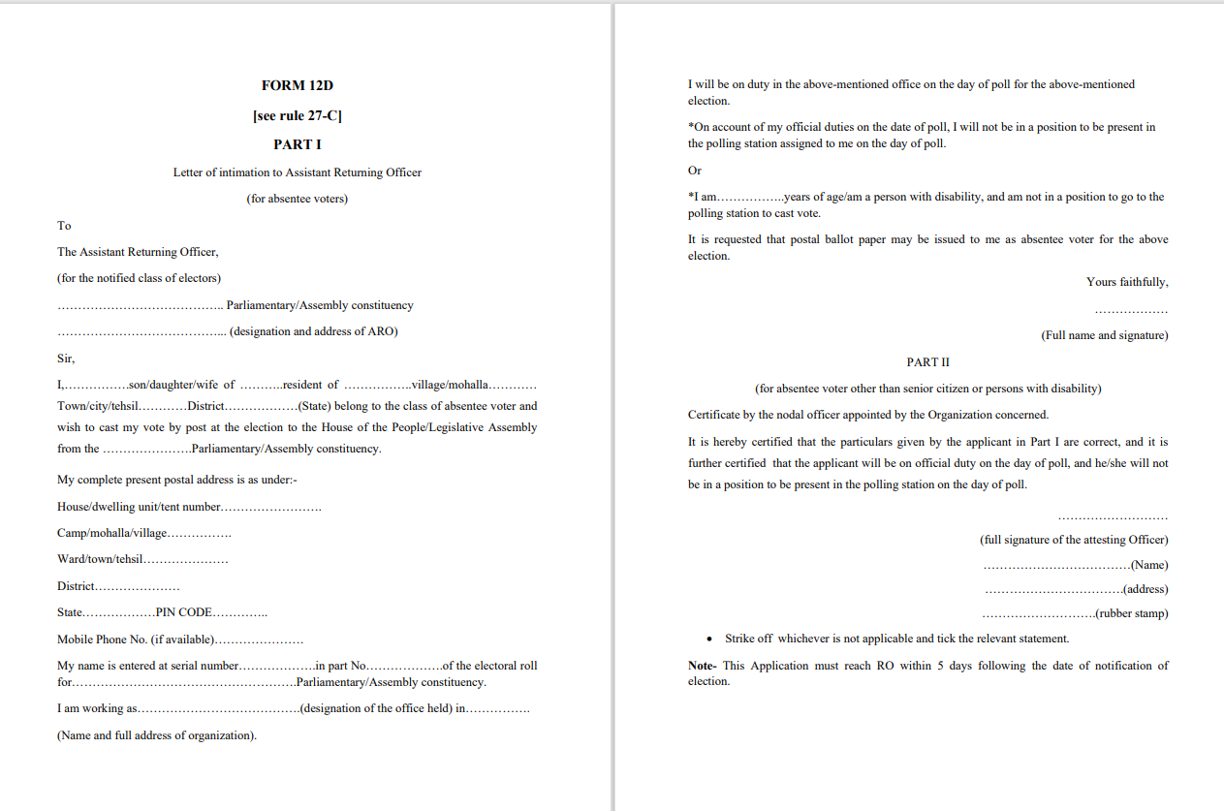
Form 12D

Slide 48
DISTRIBUTION OF FORM 12D BY BLO
Distribution and collection of Form 12 D:
BLO will distribute Form 12D to AVSC & AVPD and obtain acknowledgment.
BLO shall deposit all the acknowledgments with the RO.
If elector is not available, BLO will share his contact details and visit again.
The elector may or may not opt for PB.
If the elector opts for PB, then the BLO will collect the filled-in Form 12D within 5 days of the notification and deposit it with the RO.
Sector Officer shall supervise it under the overall supervision of RO.
PB marking is done in ER, printed list of such electors will be provided to contesting candidates.
NB 1: Please note that AVPB is an option available to those who can’t visit the polling station due to their physical condition. The ECI policy is to encourage all voters to come to polling Station. Hence, adequate publicity through SVEEP should be made about facilities such as wheelchair, volunteers, ramps, sign language etc. provided at the PS.

Slide 49
contd.
Constitution of Mobile Polling Teams:
Separate teams of poll officers, comprising two officials be formed at least one not below the rank of PO.
No. of teams of Polling Officials to be appointed depend on the number of such Absentee Voters.
The team shall visit the electors at the address mentioned in Form 12D for facilitating their voting by PB paper. Police Security cover shall be provided to the poll officers for their visits.
Entire process of voting should be videographed while maintaining secrecy of vote.
Visits by teams of poll officers should be completed by 1 day prior to the date fixed for polls.
NB: Candidates/agents have a right to know the schedule of visit of mobile polling parties and to accompany them. However, under no circumstances can the secrecy of the vote be violated. It should be ensured that the voter is not exposed to any influence or intimidation.

Slide 50
contd.
Intimation of schedule of visit of Mobile Polling Teams:
Intimate electors, in advance, date and approximate time of visit of Poll Team through SMS. If mobile no. not available, intimation be given by post and /or through the BLO.
If elector is not present at the 1st visit, the team shall leave intimation about the time of 2nd visit. If the elector is not present even at the 2nd visit, no further visit or action required.
Inform candidates about schedule of visit for the delivery and collection of PB. They may depute their authorized representatives, with prior intimation to the RO.
Briefing of voter regarding Form 13 A, B & C procedure.
The counterfoil with the serial number and part number of elector duly filled up shall be got detached and kept in safe custody by the team.
Polling team must be trained about the sequence of statutory declaration, of marking, folding and closing of Ballot Paper and envelops.
…

Slide 51
POSTAL BALLOT FOR AV
Application in Form 12D to RO | -During the period from date of announcement of Election to 5 days following the date of Notification of election concerned -Certificate/Instructions from the competent health authority /disability certificate be accompanied
Action by RO | -Distribution of Form 12D to BLO -Sector officer shall supervise the process of distribution and collection of form 12D -RO will draw a list in 3 categories in Annexure-1 (a) AVSC, (b) AVPD and (c) AVCO -PB be indicated in marked copy of E/R -List shall be shared with contesting candidates of recognized political parties.
Issue and collection of marked ballot papers | -Separate teams of polling officials shall visit the electors with prior notice at the address for facilitating their by PB -PB is issued to each absentee voter, procedure is briefed maintaining secrecy of voting -Forms 13A, 13B and 13C are used -Then PB is collected
Precautions | Police Security cover shall be provided and videography of the proceeding shall be arranged.
Completion date line | Visits should be completed one day prior to the date fixed for poll in the constituency
Safe custody | ARO shall collect envelops containing marked PB and counterfoils and deposit to RO daily for safe custody.

Slide 52
AVES- ABSENTEE VOTER FROM ESSENTIAL SERVICE
ECI from time to time notified the category of persons employed in the essential services.
Therefore, the facility of postal ballot is extended from time to time by ECI notification.
An illustrative list of such essential services is as ,( which may vary from state to state)
Airport Authority of India
Food Corporation of India
Indian Railway
Press Information Bureau
Electricity Department
Health and Family Welfare
Food and Civil Supply
Media Persons authorized by ECI for Poll day Coverage

Slide 53
POSTAL VOTING CENTER [ PVC]
AVES shall be duly intimated about the
(i) The full address of the PVC;
(ii) Dates on which the PB voting facility will remain open;
(iii) The hours fixed for postal ballot voting.
They may come for casting vote on any of the three days during the hours fixed for the purpose and service identity card is must for identification.
The three days period shall be so fixed that it is completed at least 3 days before the date fixed for poll in the constituency.
On each of the three days, the PVC shall remain open from 9 AM to 5 PM.
Those who have been approved for voting though this facility can only vote at such PVCs and not in any other manner.

Slide 54
GUIDELINES FOR VOTING THROUGH PB BY AVES
Verification of application, listing of AVES and marking PB in ER by RO:
On receipt of Form-12D, the RO will do scrutiny & will prepare list of AVES.
The RO shall thereafter arrange to issue PB to them at Postal Voting Centers (PVCs).
‘PB’ entry in marked copy of the ER.

Slide 55
GUIDELINES FOR VOTING THROUGH PB BY AVES
Intimation to candidates, personnel and SOP at PVC:
Candidates /agents may watch the proceedings in the PVC.
Attestation of Declaration in Form 13A by the gazetted officer.
Identity verification before issuing PB paper.
A tick mark be placed against the name of the elector in the list of AVES.
The counterfoil be kept in safe custody to be sent to the RO along with envelopes containing polled postal ballots.
After closing the large envelope, the voter will drop it in the box kept in the PVC.

Slide 56
GUIDELINES FOR VOTING THROUGH PB BY AVES
Daily end-of-poll procedure at PVC:
On each day after the poll closes, the envelopes in Form 13C in the drop box shall be taken out, and sealed in a larger packet superscribed “Postal Ballots in PVC”. On the outer packet, the following particulars should be clearly mentioned:
Name and number of Constituency,
Name of location of PVC,
The date on which the votes were cast,
The number of envelopes in Form 13C in the packet.
Contd…

Slide 57
GUIDELINES FOR VOTING THROUGH PB BY AVES
Sealing of counterfoils, sending packets of polled PBs and other materials to RO
The counterfoils of PB shall also be sealed in a separate packet super-scribed “Counterfoils of PBs in PVC”.
Both the packets containing the polled PBs and the counterfoils be sent to the RO in same evening.
Signature of the agents of candidates present in the PVC should be obtained on each day of voting in the PVC.
At the end of the 3 days voting period, all other material supplied to the PVC be collected by the ARO in charge of the PVC and retained at the HQ.
If any AVES does not turn up for voting in PVC, there is no requirement of sending the PB by post.
NB: The mode of voting prescribed for AVES is voting at PVC only .

Slide 58
Postal Ballot - Process flow
Assessment of Requirement of PB
Printing & Dispatch of PB
Sealing of Counterfoils and Marked Copy of Electoral Roll
Recording of Vote in Postal Ballot by Voter concerned
Return of Postal Ballot Papers
Monitoring & Storage of Postal Ballots received by Post
Record of received Postal Ballot Papers
Safe Custody of PBs Returned Undelivered
Counting of Postal Ballot Paper

Slide 59
ISSUANCE OF PB TO SPECIAL VOTERS
PB may be delivered or caused to be delivered personally to a special voter in place of sending by registered post.
PB to be issued as expeditiously as possible.
Write "W" on the cover in Form 13 C (Outer Envelope) in case of female voter.

Slide 60
SERVICE VOTERS - ETPB

Slide 61

Journey of ETPB
The implementation of ETPBMS is a time bound activity where each officer has to complete the assigned responsibility in the given time.
1
5
2
4
Counting Day
The RO will receive the postal ballot through post till 7:59 AM on the day of counting.
Announcement of Election
ECI-ADMIN to announce the election in ETPBMS system.
3
Last Date of making Nominations
ERO to populate the final list of service voter from the Service Voter Portal and upload on the ETPBMS
7 Days to download e-PB & PIN
Record officer and Unit Officer to download the e-PB PIN and e-PB respectively and hand over to the service voter.
The Service voter will take the print, cast the vote and dispatch by post.
Last Date of withdrawal
RO has to prepare the Ballot paper as Form 7A & add NOTA.
Transmit the e-PB and PIN before 3:00 PM by next day.

Slide 62
POSTAL BALLOT COUNTING
Declaration Form 13A
Declaration in (Form 13A) is defective
Form 13 A and 13 B will be kept in 13C
Separate Packet
Cover B (Form 13C) received in time
Sealed
Postal Ballot/ETPB
Cover A (Form 13B) containing PB
Declaration in (Form 13A) is correct
Opening of Cover A (PB)
Cover B (Form 13C) received after commencement of counting
Postal Ballot Paper
PB Accepted
Rejected
Candidate wise Sorting
PB Rejected
Sealed
Tally Sheet for PB
Mandatory Re-verification- of rejected Postal Ballot Received> Victory Margin
Enter in Result Sheet 20

Slide 63
Counting of PB (Rule 54A)
Counting to be done at RO’s table or by ARO nominated for the purpose
Only such PBs which have been received before hour fixed for commencement of counting shall be counted
RO to share last account of PBs received back both from facilitation centres and through post with observers
Ideally, not more than 500 PBs on one counting table
For each counting table, one ARO to be deployed
One counting supervisor and two counting assistants (gazetted officers) to be deployed at each table
Additional Micro Observer at each table
Candidates entitled to appoint one counting agent for each table
EVM counting to start after 30 minutes gap from commencement of counting of PBs

Slide 64
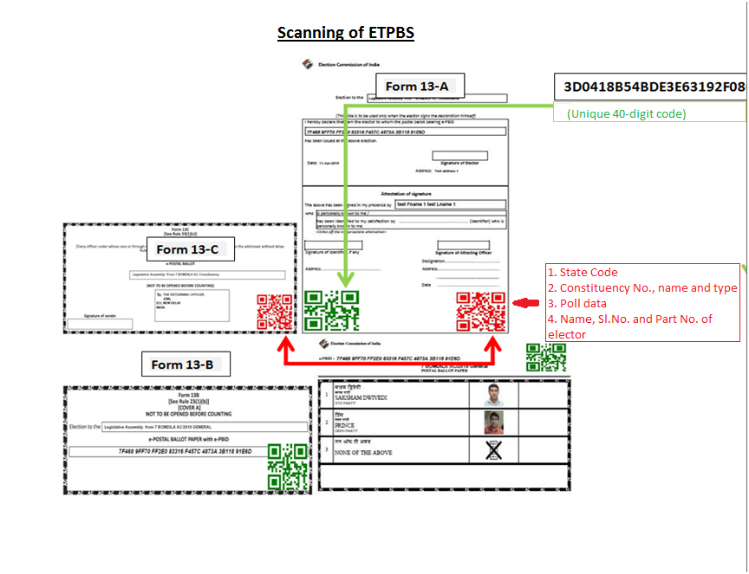
Counting of ETPBS
(Unique 40 digit code)

Slide 65
Scanning of ETPBS
Scanning of QR code on Form 13C(Cover-B) using software and QR code reader with necessary validity checks
After verification of Form 13C, unique sl. no. to be provided by system
This sl. no. to be marked manually on the envelope
Computer will check possible duplicates in QR and flag a warning
RO to locate duplicate envelope flagged by system and keep all such duplicates together physically and invalidate them
Scanning of QR codes on Form 13A and 13B
RO to reject Form 13A at this stage itself-
if ePBID(unique 40 digit code) on 13A does not match the ePBID assigned to PB at the time of dispatch of PB through ETPBS or
ePBID appearing on Form 13A is different from ePBID on Form 13B or
Other grounds of rejection such as declaration not found, signature/attestation not found etc. are the same as in case of other PBs
Scanning of QR codes on Forms 13C, 13A and 13B of one elector to be completed in one go

Slide 66
ePBID appearing on Form 13A is different from ePBID on Form 13B or
Other grounds of rejection such as declaration not found, signature/attestation not found etc. are the same as in case of other PBs
Scanning of QR codes on Forms 13C, 13A and 13B of one elector to be completed in one go
Process of Scrutiny and Counting
Opening of Form 13C- should be verified whether in the statutory form/envelope (not to be rejected if signature is not there, however, from Form 13A identity of sender is established)
Checking of Form 13A- grounds of rejection-
Form 13A not found
Sl. No. of PB mentioned on Form 13A differs from sl. no. on Form 13B
Defective

Slide 67
Declaration not signed/not attested (authorised attesting authority- (a) Service voters- commanding officer/unit officer/officer appointed by them, (b) Service voters employed in missions- officer appointed by diplomatic/counsular representative of India in the said country, (c) Declared office holders- officer not below Deputy Secretary to GoI/State, (d) voters on election duty- gazetted officer/presiding officer incase of EDC ,(e) preventive detention- Jail Superintendent/Commandant of detention camp, (f) absentee voters- senior member of poll team)
Form 13A not to be rejected merely on the ground that the attesting officer has not put his seal if he has mentioned his name and designation
Form 13B not to be opened in case Form 13A is rejected- endorsement to be made on Form 13B
All such rejected Form 13B along with Form 13A to be replaced in Form 13C and after putting all rejected Form 13C in a separate packet shall be sealed

Slide 68
Name of the constituency, date of counting and description of contents to be mentioned on such packet
All Form 13A found to be in order to be placed in separate packet and sealed before any Form 13B is opened
Name of the constituency, date of counting and description of contents to be mentioned on this packet
Form 13B in respect of which Form 13A found valid to be scrutinized
Grounds of rejection-
If not in the cover sent by RO
Damaged/mutilated and identity of elector can’t be established
If in order, PB to be taken out and counted

Slide 69
Grounds for Rejection (Rule 54A (8))
If not returned in the statutory covers
Form 13A not found
Declaration not duly signed or not attested by competent authority
Difference of sl. no. of PB and sl. no. on Form 13B
Signature or identifiable sign of elector on PB
Otherwise substantially damaged/mutilated and identity as genuine PB can’t be established
PB is spurious
No choice indicated or choice indicated for more than one candidate or choice is doubtful (however, a PB shall not be rejected merely on the ground that the mark of vote is indistinct or made more than once in the same box, if intention to vote in favor of a particular candidate is clear)

Slide 70
No particular mark for indicating vote. Any mark to be accepted as valid, if intention of voter to vote for a candidate is clear beyond doubt
All valid votes to be counted, account to be fed in result sheet (Form 20) and announce the same
All valid and rejected PBs to be bundled separately and kept together in a packet
Packet to be sealed with seal of RO and seals of candidates/election agents/counting agents who may desire
Details of constituency, date of counting and brief description of contents on the packet
Mandatory re-verification of all rejected PBs incase margin of victory is less than total number of PBs rejected as invalid
RO and Observer to record their finding of re-verification and finalise the result
Entire counting proceeding to be videographed without compromising secrecy of PBs and video cassettes/CDs to be sealed in separate cover
Counting of EVMs can go on irrespective of stage of PB counting

Slide 71
Questions
Who is entitled to avail facility of voting through postal ballot ?
What is the Form in which the application for postal ballot by an absentee voter can be made and where one can get copy of that Form?
Which authority issues postal ballot to absentee voters?
What are the conditions which a Person with Disability has to fulfill to avail facility of postal ballot?
When does the Returning Officer mark postal ballot in electoral roll?
Is it mandatory for all electors in the categories of absentee voter to vote through postal ballot?
At what stage , Returning Officer should share information / list of absentee voters in the categories of 80+ electors and Persons with Disabilities with the contesting candidates?

Slide 72
Whether an absentee voter in PWD category on the ground of blindness or physical infirmity take assistance of an adult person for marking postal ballot , and if so , what formalities have to be completed by the companion and the polling officer?
What is to be written on the counter foil of the Postal Ballot Paper?
What is written on the Envelope 13B?
Which form filled by Service Voter for obtaining Postal Ballot?
What form is to be filled by persons on election duty for being issued EDC?
Which form is used as application to apply by Absentee voters for issuing postal ballots.
Application of Absentee voters should reach to the RO before the day ?

Slide 73
Thank You

