Slide 1



SMS / Mobile App Based Poll Monitoring System
Parliament Election 2024
Office of the Chief Electoral Officer
West Bengal

Slide 2
Guidelines on SMS / Mobile Application based Poll Monitoring System
Mobile phone Nos. of RO, ARO, Sector Officer and Presiding Officer are to be registered with a given mobile number on P-3/P-2/P-1 day, respectively.
To reflect poll process related data in Poll Monitoring website and better monitoring at all levels, Presiding Officers must send SMS (using prescribed syntax) or Submit information through mobile application related to the poll activities in his Polling Station.
Presiding Officers should send the SMS or Submit information through mobile application at mentioned time and intervals positively.

Slide 3
Presiding Officers should type the syntax of the SMS or Submit information through mobile application as prescribed and should not construct their own.
Presiding Officers should be careful enough while sending Law & Order related SMS or Information by Application.
The Final Voter turn out report is mandatory and turnout data should match the data written on Presiding Officer’s dairy.
Sector Officers will be responsible for non-registration of PR/POs and they will ensure registration by P-2/P-1 day positively.
All will receive confirmation messages after successful registration
RO/ARO/SO will receive exception SMS on non-receipt of SMS from the Presiding Officers.
SO may submit information through mobile application related to the poll activities for Polling Stations under his jurisdiction if PO fails to submit.

Slide 4

Send your SMS to the following Mobile Number
SMS NUMBER
9223166166
OR
51969
OR
166

Slide 5

POLL Registration ( On P – 3 day )
Registration of RO
WB<>EL<>01<>R
: 2 (Two) digits PC No , R for Returning Officer
Registration of ARO
WB<>EL<>001<>AR
: 3 (Three digits) AC No. , AR – Assistant Returning Officer for the respective Assembly Constituency

Slide 6
POLL Registration (On P – 3 day)
Registration of SO
WB<>EL<>001<>S<>01 : 3(Three) digits AC No., S – Sector Officer, 2(Two) digits Sector No.
After Successful registration, SO will get a SMS with Mobile application download link as following.
https://drive.google.com/file/d/1m1PhJZcllORrU07FbRc1fwNrjaS6twxa/view?usp=sharing

Slide 7
POLL Registration ( Poll – 1 day )
Registration of Presiding Officer/
Polling Officer
WB<>EL<>001<>P<>001/001A
: 3(Three) digits AC no. , P – Presiding/Polling Officer ,
3(Three) digits – Polling Station No. (001A in case of auxiliary polling station)
After Successful registration, PO will get a SMS with Mobile application download link as following.
https://drive.google.com/file/d/1m1PhJZcllORrU07FbRc1fwNrjaS6twxa/view?usp=sharing

Slide 8
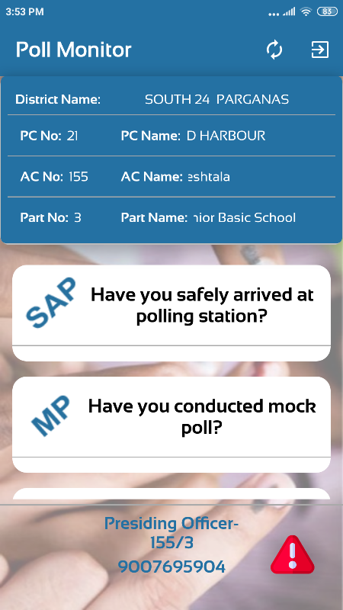
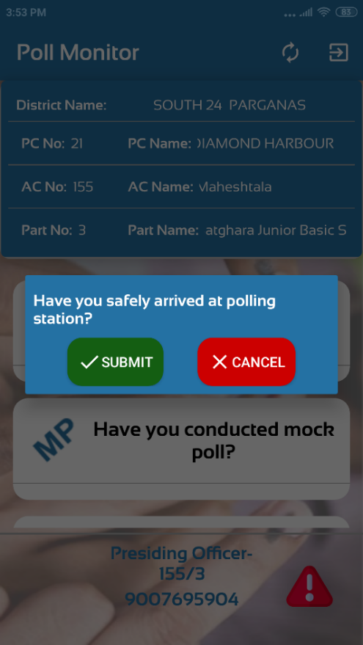
POLL REPORT (P-1 day)
Report on Safe Arrival at Polling Station
WB<>EL<>SAP : SAP – Polling Party Safely Arrived at the Polling station

Slide 9
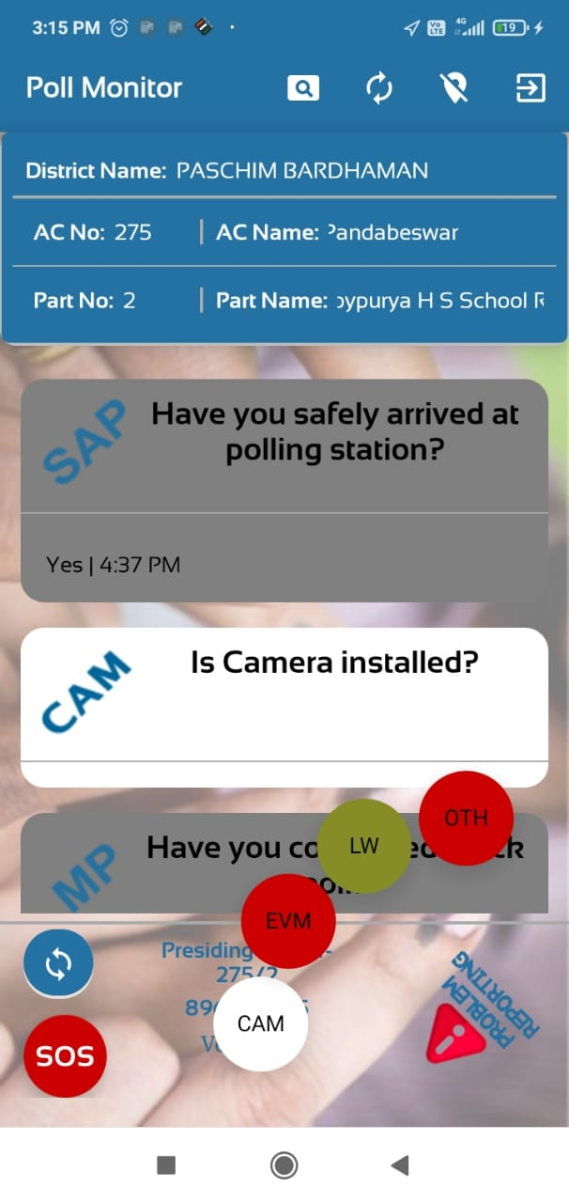
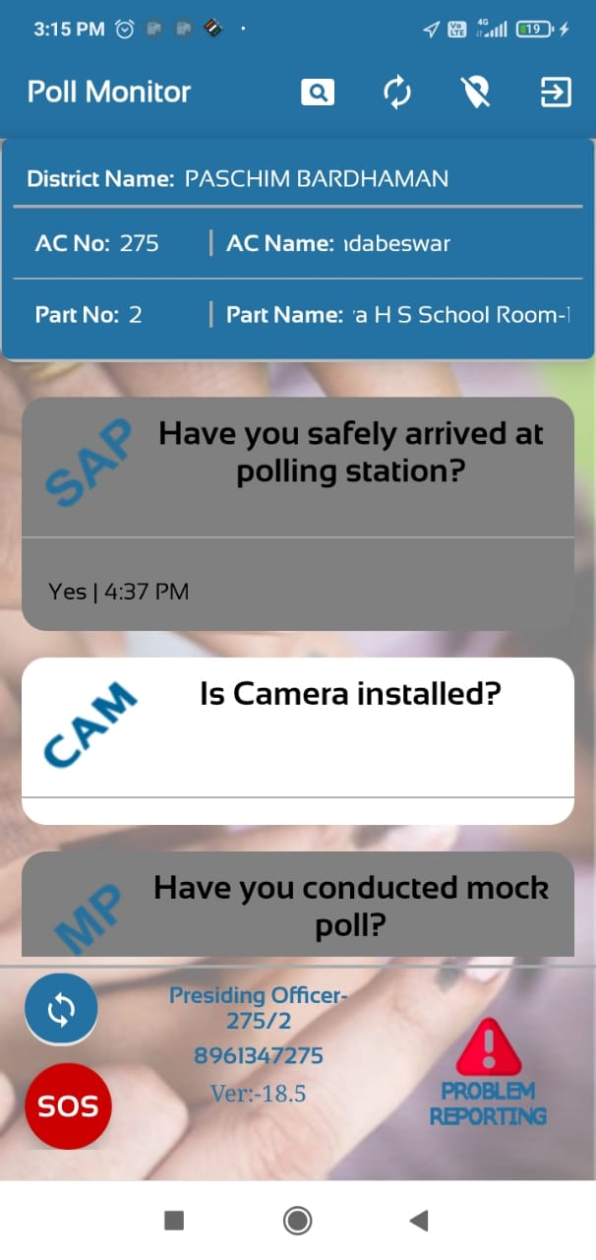
After safely arriving at the polling station, the Presiding/Polling Officer will check and verify whether Camera is installed in the polling station or not, for Web Casting. If camera is installed, then send message WB<>EL<>CAMY
OR
If not installed, then type WB<>EL<>CAMN

Slide 10
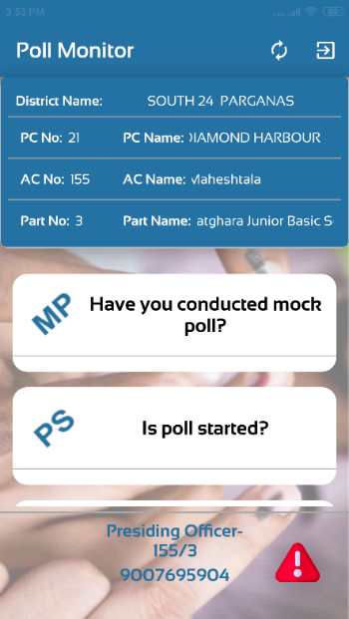
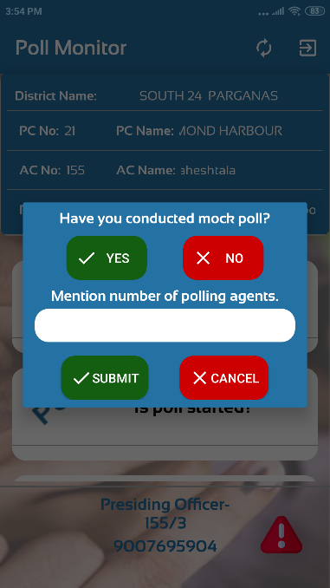
POLL Report ( Poll day)
Report on Mock Poll Conducted and Attendance of Polling agents
WB<>EL<>MP<>04
:MP – Mock poll Conducted ,
Last 2 digits stand for Total
attendance of Polling agents
Report on Poll Started
WB<>EL<>PS
: PS – Poll Started

Slide 11
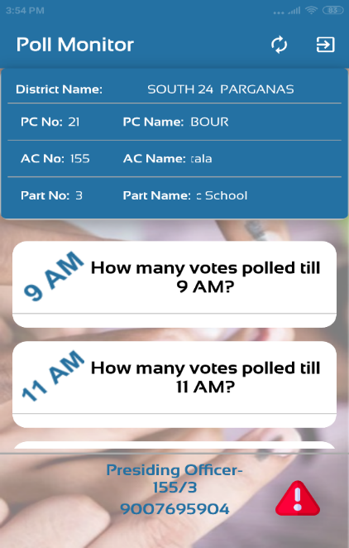
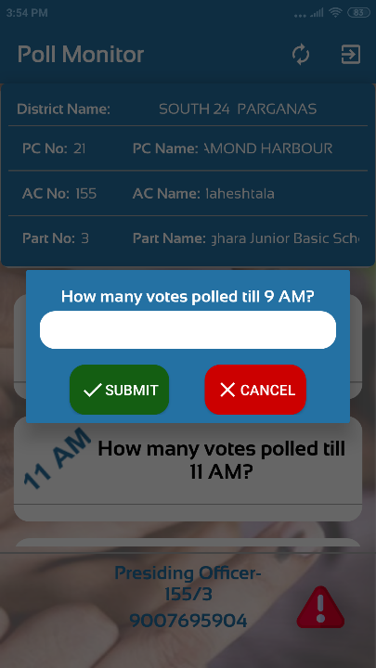
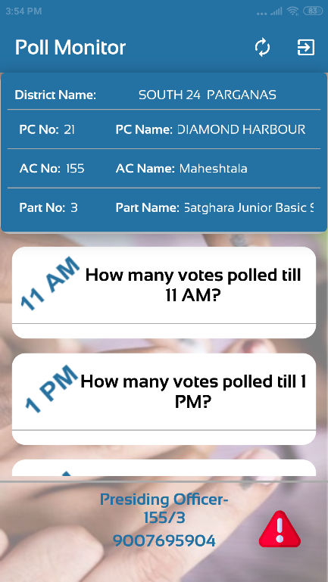
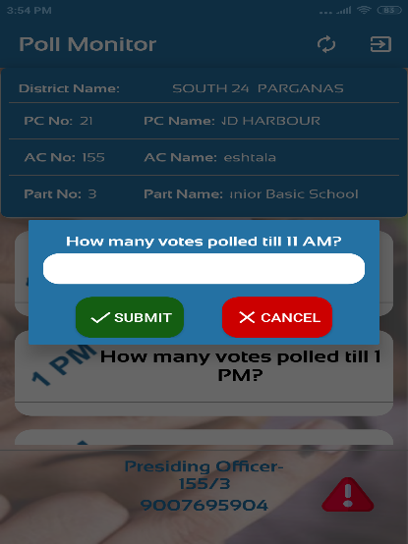
POLL Report ( Poll day)
Report on 2 hourly Poll Progress
( 9 AM , 11 AM , 1 PM , 3 PM, 5PM )
Example : If, total 245 number
of Voters have exercised their votes till a particular time ( say at 11 am)
Check the total
WB<>EL<>(any number /digit)
: Type WB EL 245
This figure should be cumulative till the reporting time

Slide 12
POLL Report ( Poll day)
Report on 2 hourly Poll Progress
( 9 AM , 11 AM , 1 PM , 3 PM, 5PM )
Poll day 2 hourly Poll Progress vote count report and also include One more report for Web Casting- whether Camera is working or not.
If Web-casting camera is working, then type WB<>EL<>CAMW
If Web-casting camera is not working, then type WB<>EL<>CAMNW

Slide 13
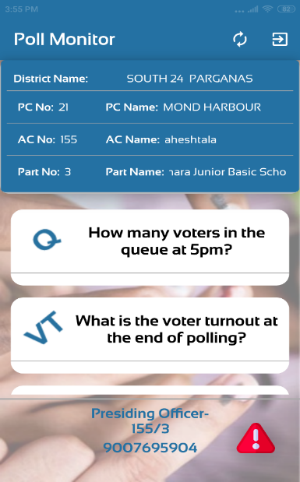
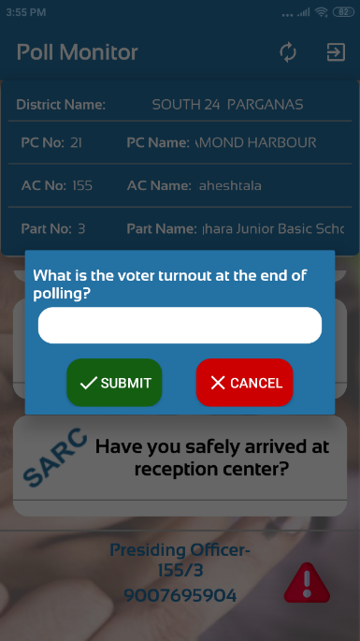
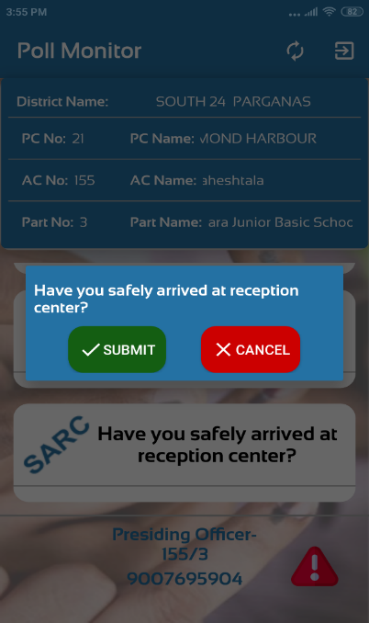
POLL Report (Poll day)
Report on Voters in Queue at 6.00 PM
WB<>EL<>Q<>018
: Q- Stands for Voters in queue at 6:00 PM ( Figure has to be given in 3 digits)
Report on Final Voter Turnout
WB<>EL<>VT<>1260
: VT – Stands for Total Voter Turn out at the end of Polling
Report after reaching RC
WB<>EL<>SARC
: SARC – Stands for Safe Arrival of Polling party at Receiving Centre

Slide 14
POLL Problem Reporting ( Poll day )
By Presiding Officer/ Polling Officer
Problem of EVM/ VVPAT Non-Functioning
WB<>EL<>EVM
: Indicates EVM / VVPAT Problem
Problem of Law & Order
WB<>EL<>LW
: Indicates Law & Order Problem
Other Problem
WB<>EL<>OTH
: OTH – Indicates Other Problem
Problem of Web-casting Camera not working
WB<>EL<>CAMNW

Slide 15
Poll Problem Resolved & Poll Resumed ( Poll day )
By Presiding Officer/ Polling Officer
Problem of EVM/ VVPAT Resolved & Poll resumed
WB<>EL<>EVM <>PR
Problem of Law & Order Resolved & Poll resumed
WB<>EL<>LW<>PR
Other Problem Resolved & Poll resumed
WB<>EL<>OTH<>PR
Problem of Web-casting Camera resolved
WB<>EL<>CAMW

Slide 16
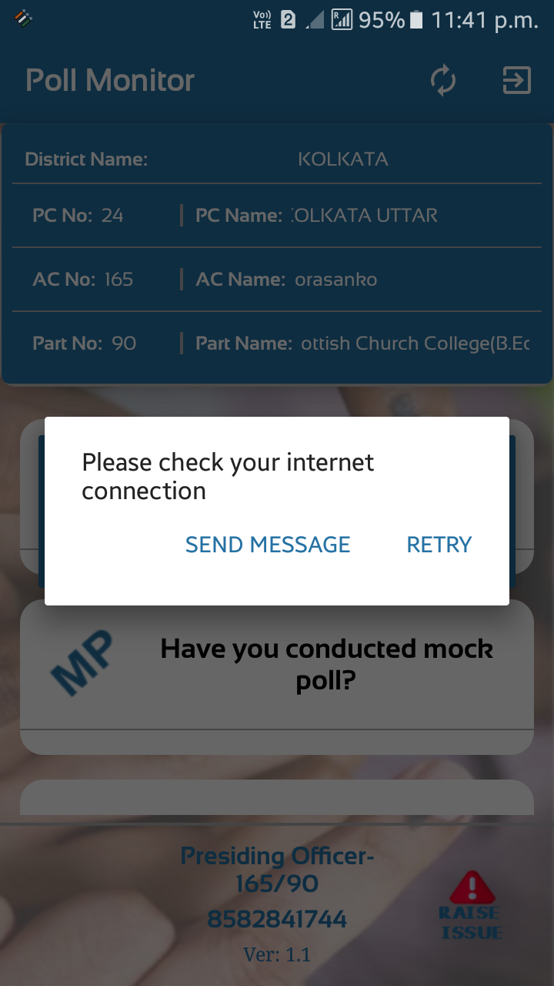
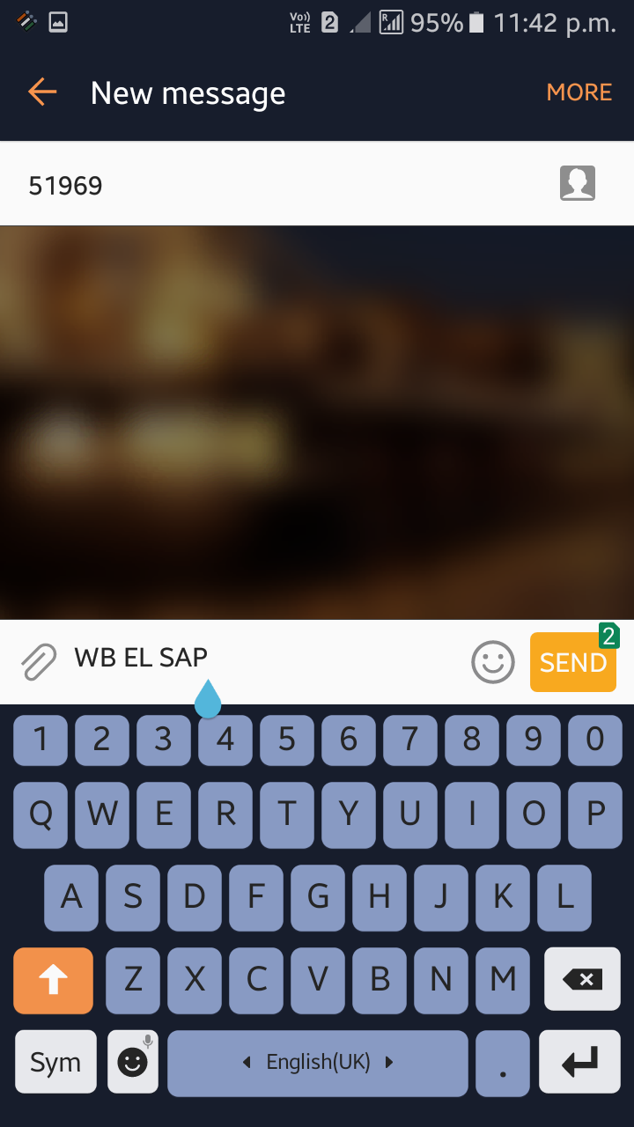
Mobile App have only Android based version (Lollipop and upward
version) and may be operational in both offline and online mode
offline/no internet
Automatic syntax of SMS will be prepared

Slide 17


POLL MONITORING OUTGOING SMS CONFIRMATIONS
POLL Registration ( On P – 3 days )
Registration of RO :You have been successfully registered as the RO for PC 01
Registration of ARO : You have been successfully registered as the ARO for AC 001
Registration of SO :You have been successfully registered as the SO for PS No. 1,2,3,4,5,610,15 under AC 001

Slide 18
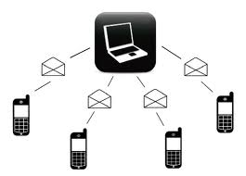
POLL MONITORING OUTGOING SMS CONFIRMATIONS
POLL Registration (Poll – 1 day)
Registration of Presiding Officer/ Polling Officer
You have been successfully
registered as the PRO/PO for
PS No. 001 under AC 001
F
OR
FOR Auxiliary Polling Station
You have been successfully
registered as the PRO/PO for
PS No. 001A under AC 001

Slide 19
POLL MONITORING OUTGOING SMS CONFIRMATIONS TO RO / ARO / SECTOR Officers
Problem of EVM/VVPAT Non-Functioning
Problem of EVM Reported at PS
No. 001/001A. Immediate Action Requested.
Problem of Law & Order
Problem of Law & Order Reported at PS No. 001/001A. Immediate Action Requested
Other Problem
Other Problem Reported at PS No. 001/001A.
Immediate Action Requested

Slide 20
Exception Reporting
(Poll – 1 day & Poll day)
To RO / ARO / SECTOR Officers
Safe Arrival from DC to Polling Stations :Updates of Safe Arrival not recd. for PS 1,2,5,18,21,34,87,54
Mock Poll Conducted :Updates of Mock Poll not recd. for PS 1,2,5,18,21,34,87,54
Poll Started :Updates on Poll Started not recd. for PS 1,2,5,18,21,34,87,54

Slide 21
Exception Reporting
( Poll day & Poll – 1 day)
TO RO / ARO / SECTOR Officers
9 AM Poll Status Update :Poll Status Update at 9 AM not received for PS 1,2,5,18,21,34,87,54
11 AM Poll Status Update :Poll Status Update at 11 AM not received for PS 1,2,5,18,21,34,87,54

Slide 22
Exception Reporting
( Poll day/ Poll – 1 day)
TO RO / ARO / SECTOR Officers
1 PM Poll Status Update :Poll Status Update at 1 PM not recd. for PS 1,2,5,18,21,34,87,54
3 PM Poll Status Update :Poll Status Update at 3 PM not recd. for PS 1,2,5,18,21,34,87,54
5 PM Poll Status Update :Poll Status Update at 5 PM not recd. for PS 1,2,5,18,21,34,87,54

Slide 23
Exception Reporting - Poll day
To RO / ARO / SECTOR Officers
Voters in queue at 6.00 PM :Voters in queue report not recd. for PS 1,2,5,18,21,34,87,54 (if VTR also not received)
Voter Turnout Report :Voters turnout report not recd. for PS 1,2,5,18,21,34,87,54
Safe Arrival at RC :Safe Arrival at RC report not recd. for PS 1,2,5,18,21,34,87,54

Slide 24
SYNOPSIS
Presiding Officers have to send 22 SMS or submit inputs through Mobile Application
1. Registration
For RO - WB<>EL<>01<>R
For ARO - WB<>EL<>001<>AR
For SO - WB<>EL<>001<>S<>01
For PO/PRO - WB<>EL<>001<>P<>001/001A
2. Safe Arrival at Polling Station
WB<>EL<>SAP
3. Mock Poll
WB<>EL<>MP<>04 (No. of Polling
Agents)

Slide 25
SYNOPSIS
Presiding Officers have to send 20 SMS or submit inputs through Mobile application
4. Poll Start
WB<>EL<>PS
5. 2 Hourly report : 9 AM
WB EL 245 (where 245 stands for total votes
polled at a given time, i.e., 9 AM)
6. 2 Hourly report : 11 AM
WB EL 445 (where 445 stands for total votes
polled at a given time, i.e., 11 AM)
7. 2 Hourly report : 1 PM
WB EL 645 (where 645 stands for total votes
polled at a given time, i.e., 1 PM)
8. 2 Hourly report : 3 PM
WB EL 845 (where 845 stands for total votes
polled at a given time, i.e., 3 PM)

Slide 26
SYNOPSIS
Presiding Officers have to send 20 SMS or submit inputs through Mobile application
9. 2 Hourly report : 5 PM
WB EL 900 (where 900 stands for total votes
polled at a given time, i.e., 5 PM)
10. If camera is installed, then send message
WB<>EL<>CAMY
11. If camera is not installed, then send message
WB<>EL<>CAMN
12. Problem of EVM/ VVPAT Non- Functioning
WB<>EL<>EVM
Indicates EVM / VVPAT Problem

Slide 27
SYNOPSIS
Presiding Officers have to send 20 SMS or submit inputs through Mobile application
13. Problem of Law & Order
WB<>EL<>LW
Indicates Law & Order Problem
14. Other Problem
WB<>EL<>OTH
OTH – Indicates Other Problem
15. Problem of Camera not working
WB<>EL<>CAMNW
16. Problem of EVM/ VVPAT Resolved & Poll resumed
WB<>EL<>EVM <>PR
17. Problem of Law & Order Resolved & Poll resumed
WB<>EL<>LW<>PR

Slide 28
SYNOPSIS
Presiding Officers have to send 20 SMS or submit inputs through Mobile application
18. Other Problem Resolved & Poll resumed
WB<>EL<>OTH<>PR
19. Problem of Camera resolved
WB<>EL<>CAMW
20. Voters in Queue at 6.00 PM
WB<>EL<>Q<>018
21. VTR (At close of poll)
WB<>EL<>VT<>1260
22. Safe Arrival at Receiving Centre
WB<>EL<>SARC

Slide 29
THANK YOU

